Slide 1

I save on my bills by monitoring my linky meter.

Slide 2




Hello !
Victor Vitcheff
Co-op data student @ OVHcloud
victor.vitcheff
Victor2103

Slide 3

Why monitoring my bills ?
Seriously?
EDF bills me
100€ per month.
Does someone have
a solution ?
Limit my consumptions
Get some alert when abnormal activity
And much more … sky is the limit :)
Why not using the EDF or Enedis app ?

Slide 4
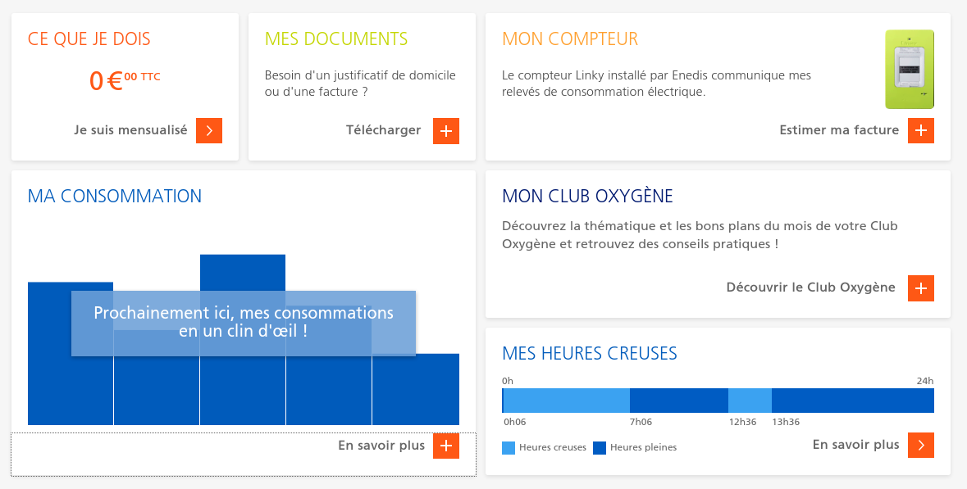
Official App : EDF

Slide 5
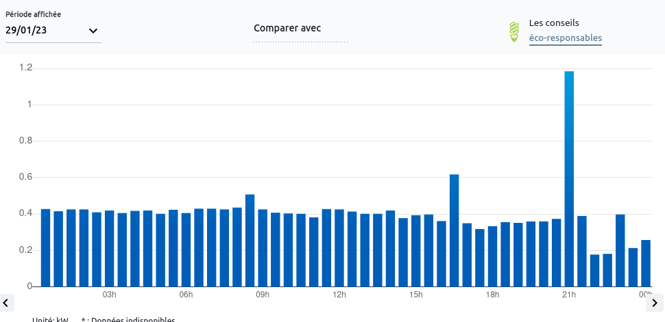
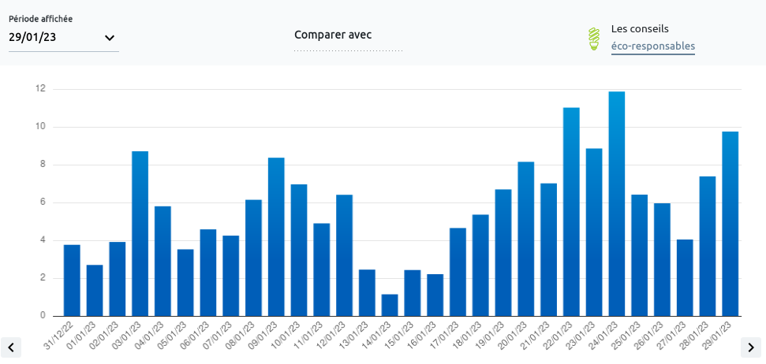
Official App : Enedis

Slide 6




I want more !
More accuracy, per minutes
Bills forecast in euros
Alerting
Better dashboard visualization
….
Good luck…

Slide 7

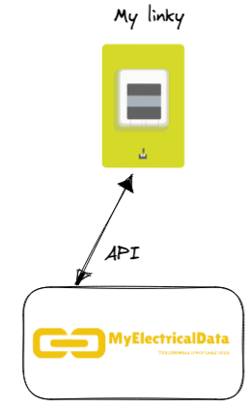

Step 1 : get my Linky data
Can i get access to Enedis API ???
My Electrical Data to the rescue
https://myelectricaldata.fr/
And now ?
I save on my bills by monitoring my linky meter.

Slide 8
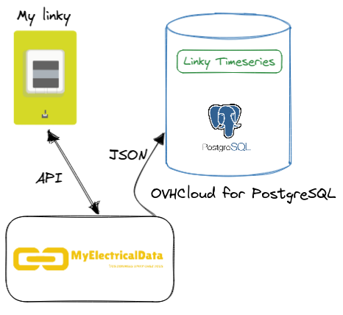
Step 2 : store my data
Ideas to store timeseries
PostgreSQL and TimescaleDB
InfluxDB ?
And now ?
I save on my bills by monitoring my linky meter.

Slide 9
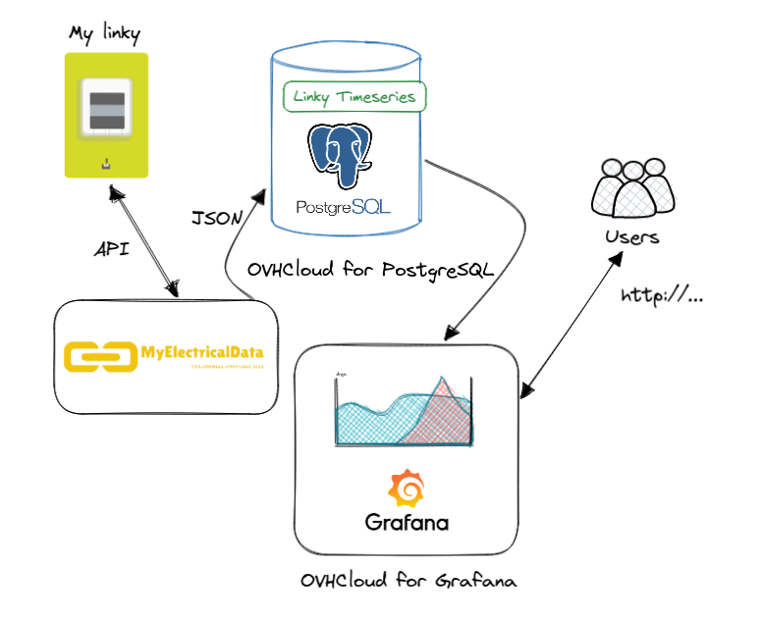
Step 3 : visualize my data
Visualisation database
Existing dashboard
Existing with OVHcloud
Open source tools, such as
Grafana and Metabase works natively with PostgreSQL.
I save on my bills by monitoring my linky meter.

Slide 10
Recap !
- Grafana on OVHcloud, Metabase locally
- PostgreSQL with timestamps
- Python for processing the data
Get the json, process it, store it and display it.
I save on my bills by monitoring my linky meter.

Slide 11
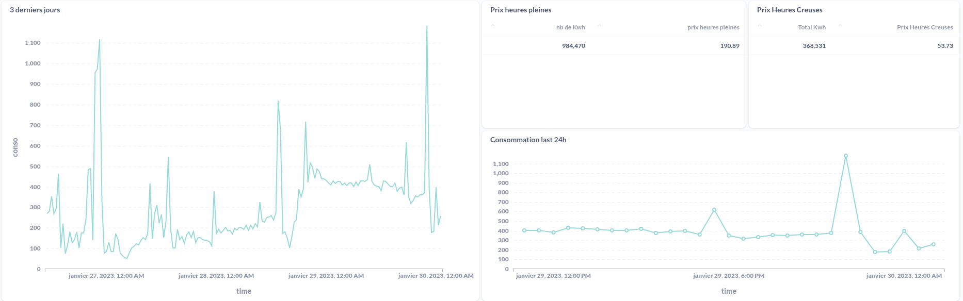
30 min timestamp
Alerting via email only
WYSIWYG Query engine
Automatic scaling
Visualize with Metabase !

Slide 12
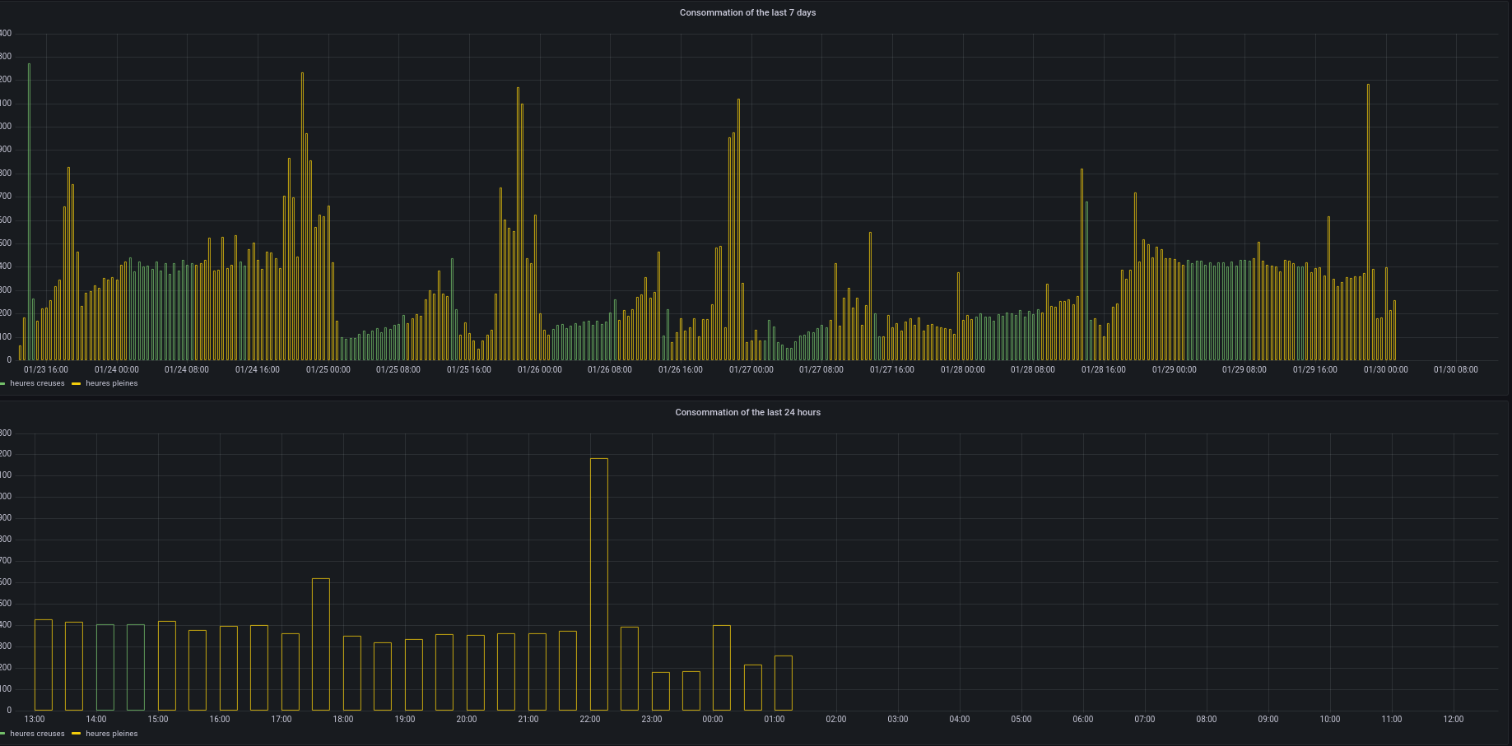
30 min timestamp
Alerting via multiple ways (Telegram,..)
Difference with off-peak and peak hours
Visualize with Grafana !

Slide 13
Demo time !
And if
I show
how it
looks ?
- Get the data
Store it
Display it
Going further and improve my PoC

Slide 14
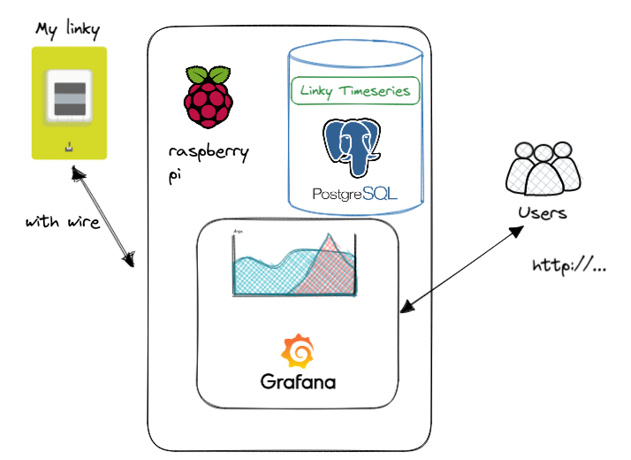
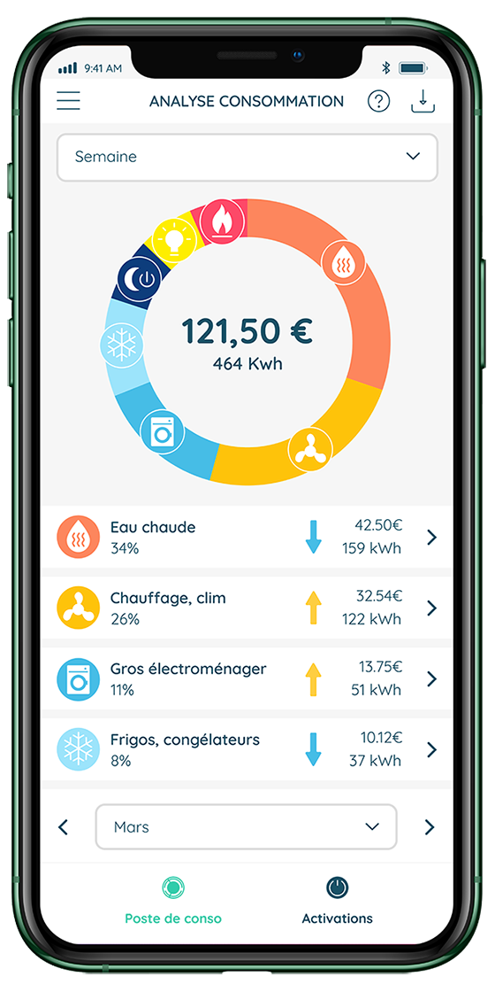
Going further
- Use a Raspberry Pi for real time data and zero cloud infra (everything is local)
- Automate the Python script
- Send alerts via Telegram
- Use specific products such as Ecojoko for categorization (heating, fridge, …)
I save on my bills by monitoring my linky meter.

Slide 15
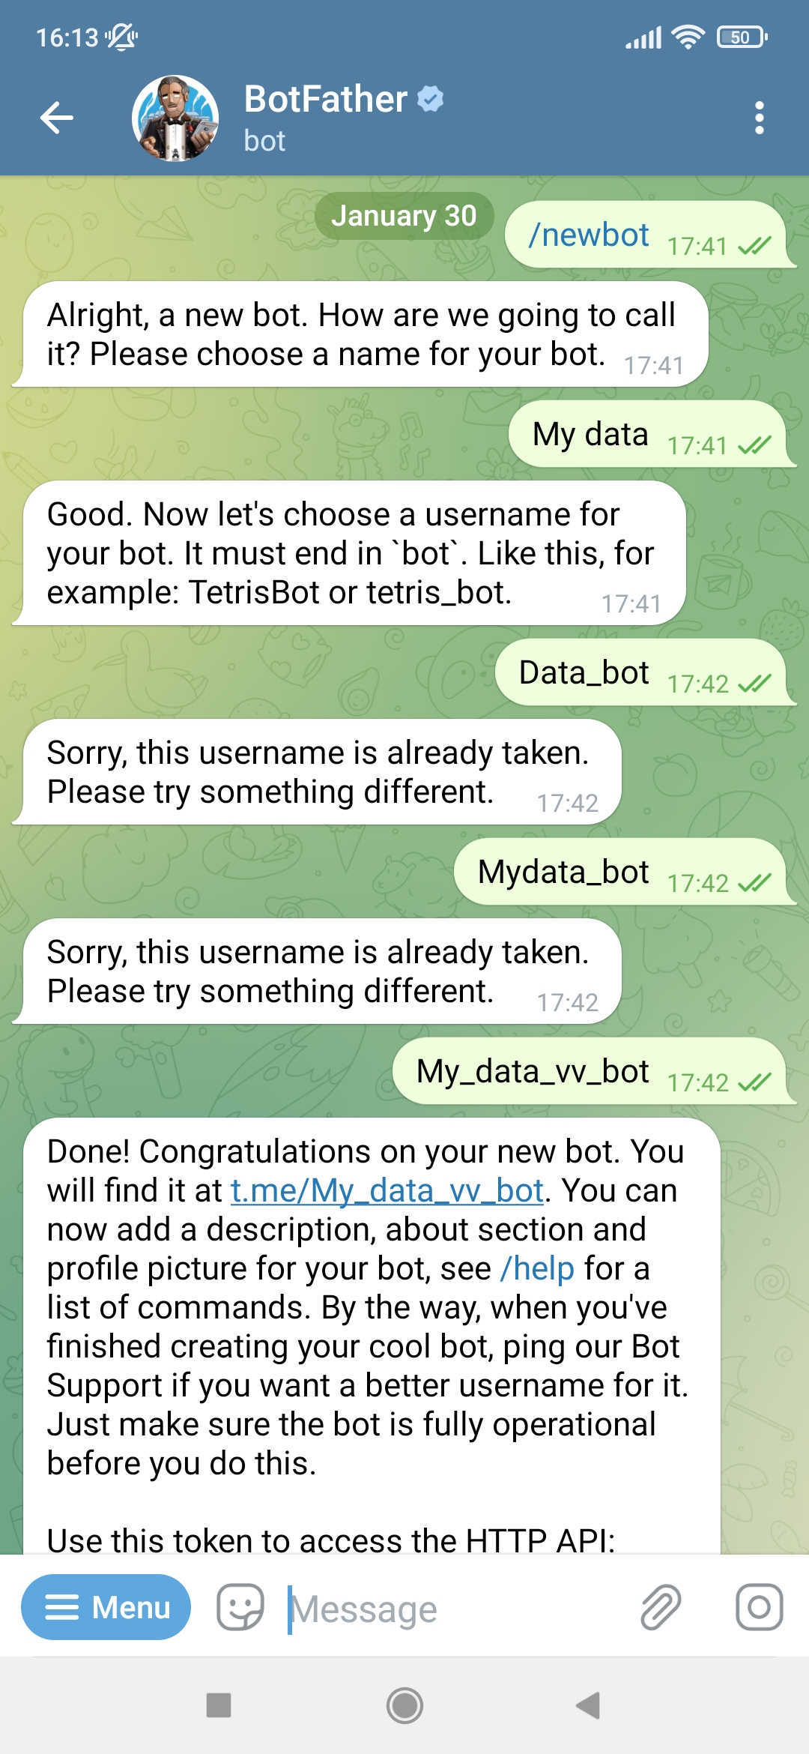
Bonus : Telegram alerting
1/ Create a bot by speaking on Telegram
2/ configure alert in grafana
3/ configure bot in grafana
I save on my bills by monitoring my linky meter.

Slide 16
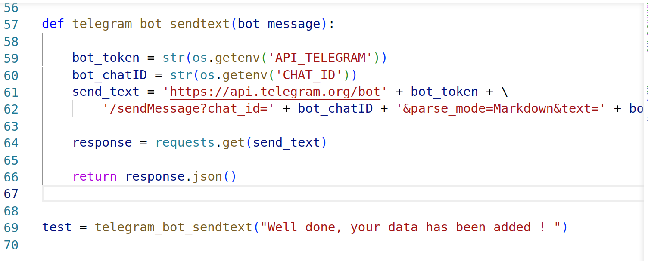
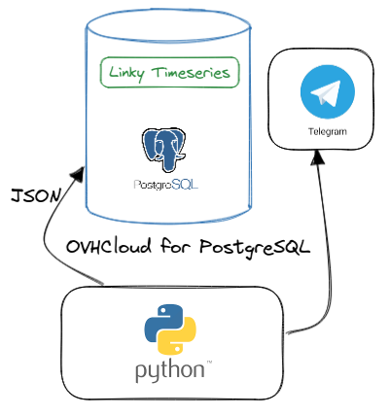
Python to Telegram !
- Goal : Send alerts when your data is added.
Only 5 lines of codes. quite simple !
I save on my bills by monitoring my linky meter.

Slide 17

Thank you !
Find me online :
victor.vitcheff
Victor2103
I save on my bills by monitoring my linky meter.

Slide 18


?
?
?
?

